Slide 1
Want to talk to R? Call your plumber
Adi Sarid,
January 2020

Slide 2
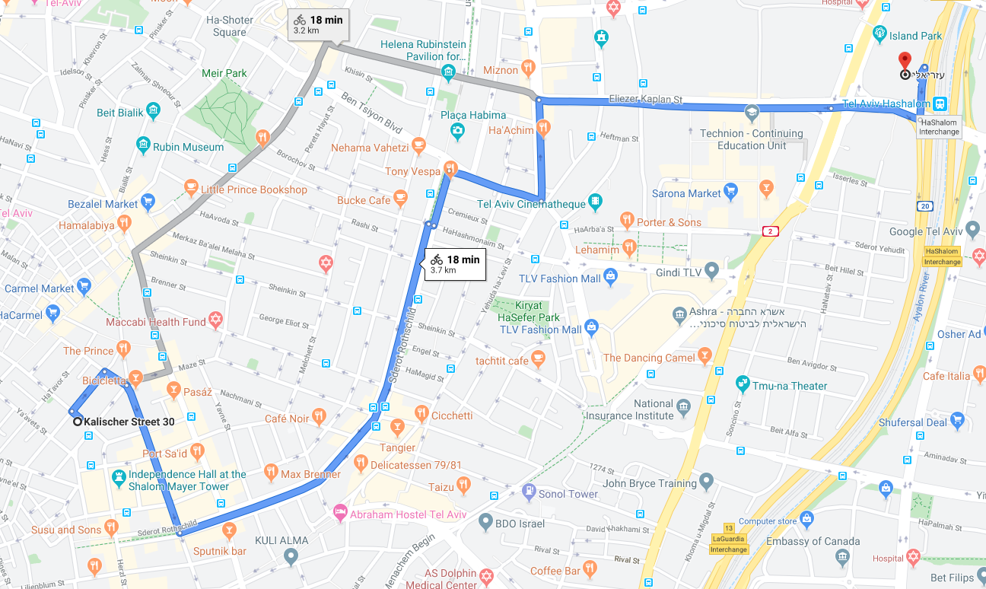
Any cyclers in the crowd?
How long does it take to ride from 30th Kalisher, Tel-Aviv to Azrieli Center?
I don’t know, but let’s ask google almighty (here)
What about
Netanya? Haifa? Beer Sheva? Metula? Kiryat Shmona? Antartica?
Many other places… We need some better way of asking

Slide 3
Ask many a big question Get many answers
Google Maps API with package `httr`
Live demo at R\google_maps_live_demo.R
In practice, if it’s a common API, look for a package instead of writing your own API interface

Slide 4

The internet is like a puzzle
Applications talk to each other via APIs (application programming interface)
Just like we asked for riding times, our code could also ask:
What are the GPS coordinates of…?, Where is that IP coming from?...
Send out an email message/SMS message
Employ machine learning algorithms
Many more services…
APIs provide amazing flexibility
And sometimes…

Slide 5

Sometimes we want to empower others!
We want to let others use our R code
Without giving them our code
Keeping our secrets/intellectual property safe
Without forcing our client to install and run R
Automate lots of stuff
Provide your models as a service
This is what plumber is all about

Slide 6



How does plumber work?
Write
Decorate
Deploy

Slide 7

Example: Where no R has gone before
Code:
R/get_startrek_quote.R
./plumber.R
Example online (just for today):
api.hebrewr.co.il:8000/__swagger__
api.hebrewr.co.il:8000/startrekquote?character_fl=WORF
api.hebrewr.co.il:8000/startrekquote?series_fl=VOY
api.hebrewr.co.il:8000/startrekquote?character_fl=skywalker
JUST COULDN’T HELP IT

Slide 8
To Summarize
RESTful APIs are extremely powerful!
It’s worthwhile to know how to use RESTful APIs to access other services from within R (i.e., package httr, jsonlite, etc.)
When you need to expose or integrate your code/models to other developers, you might want to consider building an API of your own using plumber
This can also be useful for automation of your internal processes

Slide 9
Some related resources
This presentation and all the live-coding are available
https://github.com/adisarid/startrek_plumber_api
The plumber package official documentation
https://www.rplumber.io/

Slide 10


Thanks! (Almost) Everything is here: https://github.com/adisarid/startrek_plumber_api
Adi Sarid
adi@sarid-ins.co.il
@SaridResearch
https://www.sarid-ins.co.il
https://adisarid.github.io

